Slide 1
Model Evaluation

Slide 2
Model Evaluation
Metrics for Performance Evaluation
How to evaluate the performance of a model?
Methods for Performance Evaluation
How to obtain reliable estimates?
Methods for Model Comparison
How to compare the relative performance among competing models?

Slide 3
Model Evaluation
Metrics for Performance Evaluation
How to evaluate the performance of a model?
Methods for Performance Evaluation
How to obtain reliable estimates?
Methods for Model Comparison
How to compare the relative performance among competing models?

Slide 4
Metrics for Performance Evaluation
Focus on the predictive capability of a model
Rather than how fast it takes to classify or build models, scalability, etc.
Confusion Matrix:
 | PREDICTED CLASS
ACTUAL CLASS |  | Class=Yes | Class=No
 | Class=Yes | a | b
 | Class=No | c | d
a: TP (true positive)
b: FN (false negative)
c: FP (false positive)
d: TN (true negative)

Slide 5
Metrics for Performance Evaluation
 | PREDICTED CLASS
ACTUAL CLASS |  | Class=Yes | Class=No
 | Class=Yes | a (TP) | b (FN)
 | Class=No | c (FP) | d (TN)
Most widely-used metric:

Slide 6
Limitation of Accuracy
Consider a 2-class problem:
Number of Class 0 examples = 9990
Number of Class 1 examples = 10
If the model predicts everything to be class 0, accuracy is 9990/10000 = 99.9 %
Accuracy is misleading because the model does not detect any class 1 examples

Slide 7
Cost Matrix
 | PREDICTED CLASS
ACTUAL CLASS | C(i|j) | Class=Yes | Class=No
 | Class=Yes | C(Yes|Yes) | C(No|Yes)
 | Class=No | C(Yes|No) | C(No|No)
C(i|j): Cost of misclassifying class j example as class i

Slide 8
Computing Cost of Classification
Cost Matrix | PREDICTED CLASS
ACTUAL CLASS | C(i|j) | + | -
 | + | -1 | 100
 | - | 1 | 0
Model M₂ | PREDICTED CLASS
ACTUAL CLASS |  | + | -
 | + | 250 | 45
 | - | 5 | 200
Accuracy = 90%
Cost = 4255
Model M₁ | PREDICTED CLASS
ACTUAL CLASS |  | + | -
 | + | 150 | 40
 | - | 60 | 250
Accuracy = 80%
Cost = 3910

Slide 9
Cost vs accuracy
Count | PREDICTED CLASS
ACTUAL CLASS |  | Class=Yes | Class=No
 | Class=Yes | a | b
 | Class=No | c | d
Accuracy is proportional to cost if: 1. C(Yes|No)=C(No|Yes) = q 2. C(Yes|Yes)=C(No|No) = p
N = a + b + c + d
Accuracy = (a + d)/N
Cost = p (a + d) + q (b + c)
= p (a + d) + q (N – a – d)
= q N – (q – p)(a + d)
= N [q – (q-p) × Accuracy]
Cost | PREDICTED CLASS
ACTUAL CLASS |  | Class=Yes | Class=No
 | Class=Yes | p | q
 | Class=No | q | p

Slide 10
Cost-Sensitive Measures
Precision is biased towards C(Yes|Yes) & C(Yes|No)
Recall is biased towards C(Yes|Yes) & C(No|Yes)
F-measure is biased towards all except C(No|No)

Slide 11
Model Evaluation
Metrics for Performance Evaluation
How to evaluate the performance of a model?
Methods for Performance Evaluation
How to obtain reliable estimates?
Methods for Model Comparison
How to compare the relative performance among competing models?

Slide 12
Methods for Performance Evaluation
How to obtain a reliable estimate of performance?
Performance of a model may depend on other factors besides the learning algorithm:
Class distribution
Cost of misclassification
Size of training and test sets

Slide 13
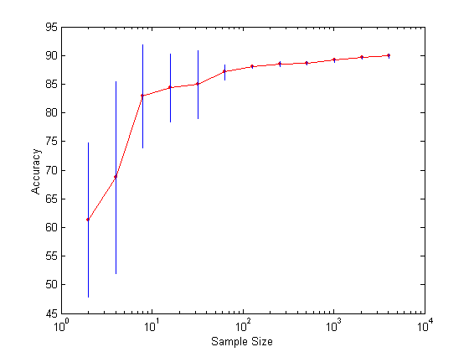
Learning Curve
Learning curve shows how accuracy changes with varying sample size
Requires a sampling schedule for creating a learning curve:
Arithmetic sampling (Langley, et al)
Geometric sampling (Provost et al)
Effect of small sample size:
Bias in the estimate
Variance of estimate

Slide 14
Methods of Estimation
Holdout
Reserve 2/3 for training and 1/3 for testing
Cross validation
Partition data into k disjoint subsets
k-fold: train on k-1 partitions, test on the remaining one
Leave-one-out: k = n
Random subsampling
Repeated holdout
Stratified sampling
Oversampling vs undersampling
Bootstrap
Sampling with replacement

Slide 15
Model Evaluation
Metrics for Performance Evaluation
How to evaluate the performance of a model?
Methods for Performance Evaluation
How to obtain reliable estimates?
Methods for Model Comparison
How to compare the relative performance among competing models?

Slide 16
ROC (Receiver Operating Characteristic)
Developed in 1950s for signal detection theory to analyze noisy signals
Characterize the trade-off between positive hits and false alarms
ROC curve plots TP (on the y-axis) against FP (on the x-axis)
Performance of each classifier represented as a point on the ROC curve
Changing the threshold of the algorithm, sample distribution, or cost matrix changes the location of the point

Slide 17
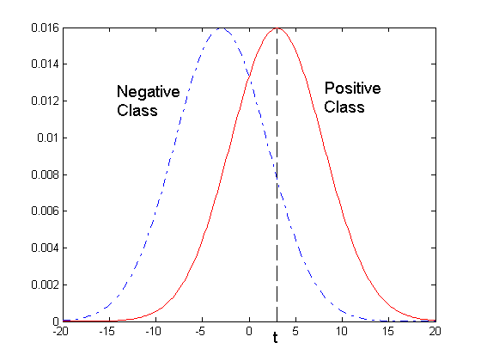
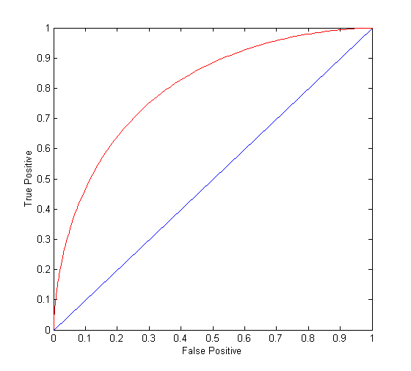
ROC Curve
1-dimensional data set containing 2 classes (positive and negative)
Any points located at x > t are classified as positive
At threshold t:
TP=0.5, FN=0.5, FP=0.12, FN=0.88

Slide 18
ROC Curve
(TP,FP):
(0,0): declare everything to be negative class
(1,1): declare everything to be positive class
(1,0): ideal
Diagonal line:
Random guessing
Below diagonal line:
Prediction is opposite of the true class

Slide 19
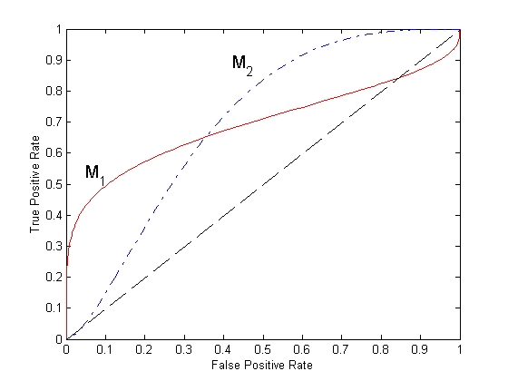
Using ROC for Model Comparison
No model consistently outperforms the other
M₁ is better for small FPR
M₂ is better for large FPR
Area under the ROC curve
Ideal:
Area = 1
Random guess:
Area = 0.5

Slide 20
How to Construct an ROC curve
Instance | P(+|A) | True Class
1 | 0.95 | +
2 | 0.93 | +
3 | 0.87 | -
4 | 0.85 | -
5 | 0.85 | -
6 | 0.85 | +
7 | 0.76 | -
8 | 0.53 | +
9 | 0.43 | -
10 | 0.25 | +
Use classifier that produces posterior probability for each test instance P(+|A)
Sort the instances according to P(+|A) in decreasing order
Apply threshold at each unique value of P(+|A)
Count the number of TP, FP, TN, FN at each threshold
TP rate, TPR = TP/(TP+FN)
FP rate, FPR = FP/(FP + TN)

Slide 21
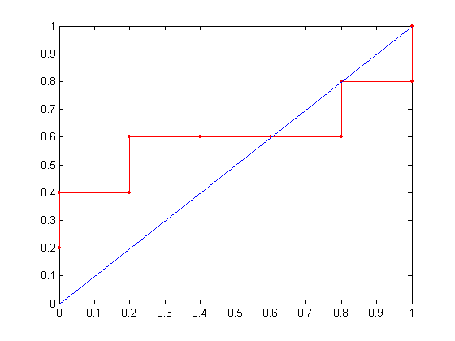
How to construct an ROC curve
Threshold >=
ROC Curve

Slide 22
Test of Significance
Given two models:
Model M1: accuracy = 85%, tested on 30 instances
Model M2: accuracy = 75%, tested on 5000 instances
Can we say M1 is better than M2?
How much confidence can we place on accuracy of M1 and M2?
Can the difference in performance measure be explained as a result of random fluctuations in the test set?

Slide 23
Confidence Interval for Accuracy
Prediction can be regarded as a Bernoulli trial
A Bernoulli trial has 2 possible outcomes
Possible outcomes for prediction: correct or incorrect
Collection of Bernoulli trials has a Binomial distribution:
x ∼ Bin(N, p) x: number of correct predictions
e.g.: Toss a fair coin 50 times, how many heads would turn up? Expected number of heads = N×p = 50 × 0.5 = 25
Given x (# of correct predictions) or equivalently, acc=x/N, and N (# of test instances), can we predict p (true accuracy of model)?

Slide 24
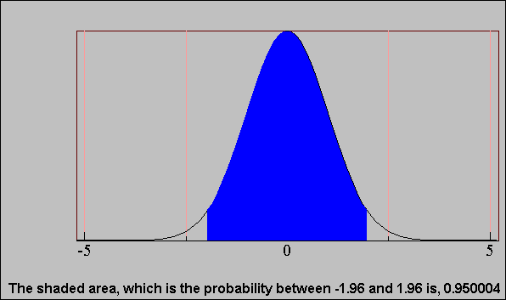
Confidence Interval for Accuracy
Area = 1 - α
For large test sets (N > 30),
acc has a normal distribution with mean p
and variance p(1-p)/N
Confidence Interval for p:
Z_{α/2}
Z_{1- α /2}

Slide 25
Confidence Interval for Accuracy
Consider a model that produces an accuracy of 80% when evaluated on 100 test instances:
N=100, acc = 0.8
Let 1-α = 0.95 (95% confidence)
From probability table, Z_{α/2}=1.96
1-α | Z
0.99 | 2.58
0.98 | 2.33
0.95 | 1.96
0.90 | 1.65
N | 50 | 100 | 500 | 1000 | 5000
p(lower) | 0.670 | 0.711 | 0.763 | 0.774 | 0.789
p(upper) | 0.888 | 0.866 | 0.833 | 0.824 | 0.811

Slide 26
Comparing Performance of 2 Models
Given two models, say M1 and M2, which is better?
M1 is tested on D1 (size=n1), found error rate = e₁
M2 is tested on D2 (size=n2), found error rate = e₂
Assume D1 and D2 are independent
If n1 and n2 are sufficiently large, then
Approximate:

Slide 27
Comparing Performance of 2 Models
To test if performance difference is statistically significant: d = e1 – e2
d ~ N(d_{t},σ_{t}) where d_{t} is the true difference
Since D1 and D2 are independent, their variance adds up:
At (1-α) confidence level,

Slide 28
An Illustrative Example
Given: M1: n1 = 30, e1 = 0.15 M2: n2 = 5000, e2 = 0.25
d = |e2 – e1| = 0.1 (2-sided test)
At 95% confidence level, Z_{α/2}=1.96 => Interval contains 0 => difference may not be statistically significant

Slide 29
Comparing Performance of 2 Algorithms
Each learning algorithm may produce k models:
L1 may produce M11 , M12, …, M1k
L2 may produce M21 , M22, …, M2k
If models are generated on the same test sets D1,D2, …, Dk (e.g., via cross-validation)
For each set: compute d_{j} = e_{1j} – e_{2j}
d_{j} has mean d_{t} and variance σ_{t}
Estimate:

